Slide 1


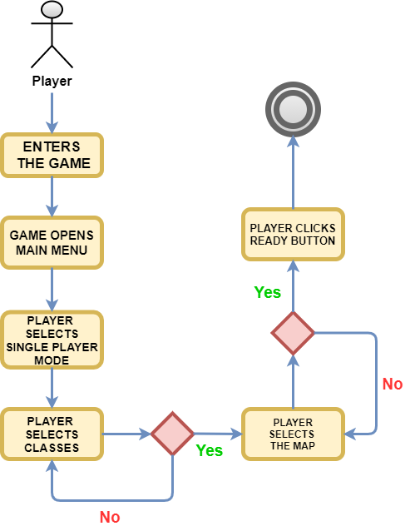
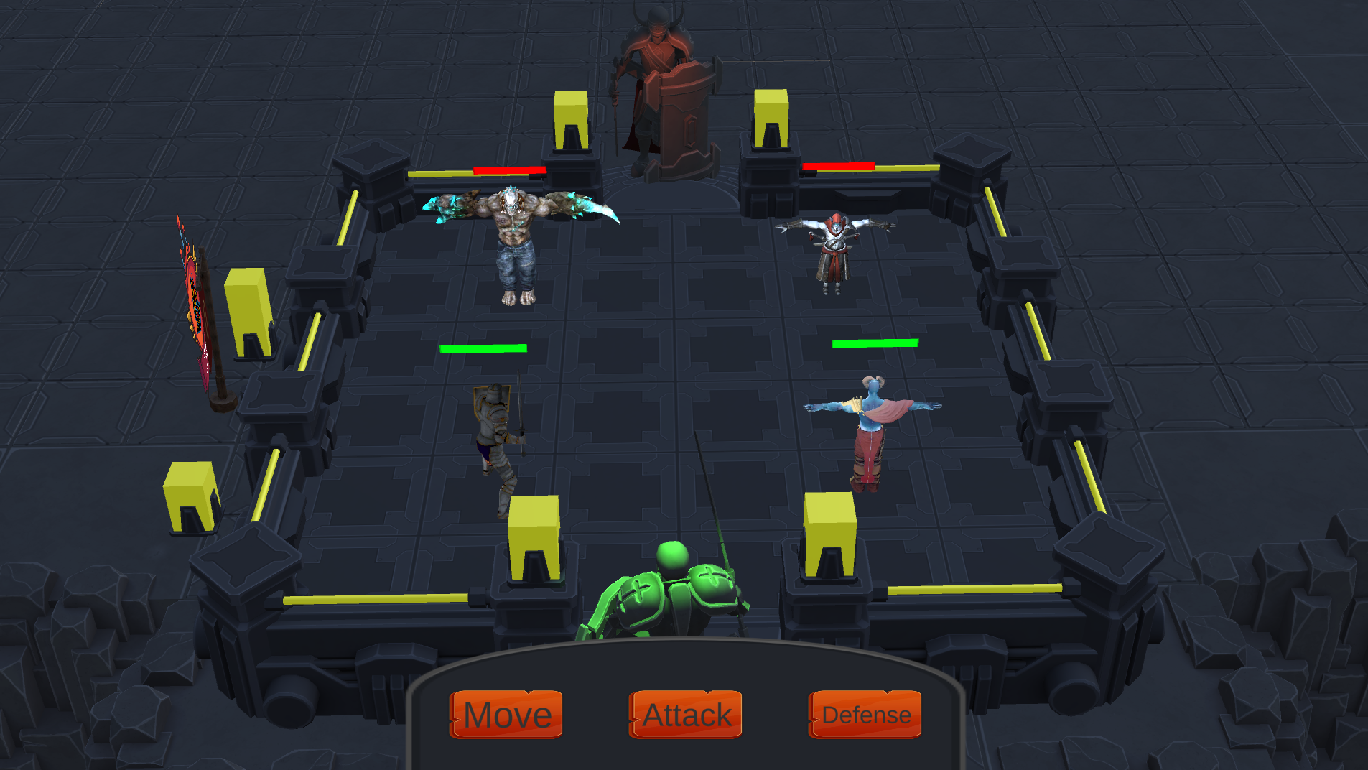
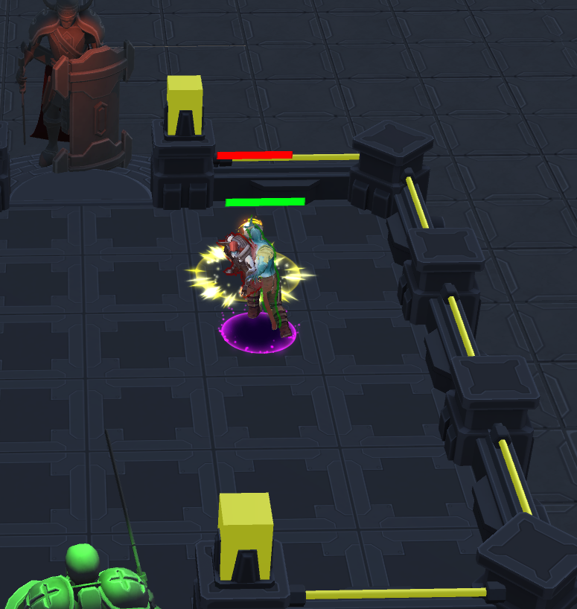
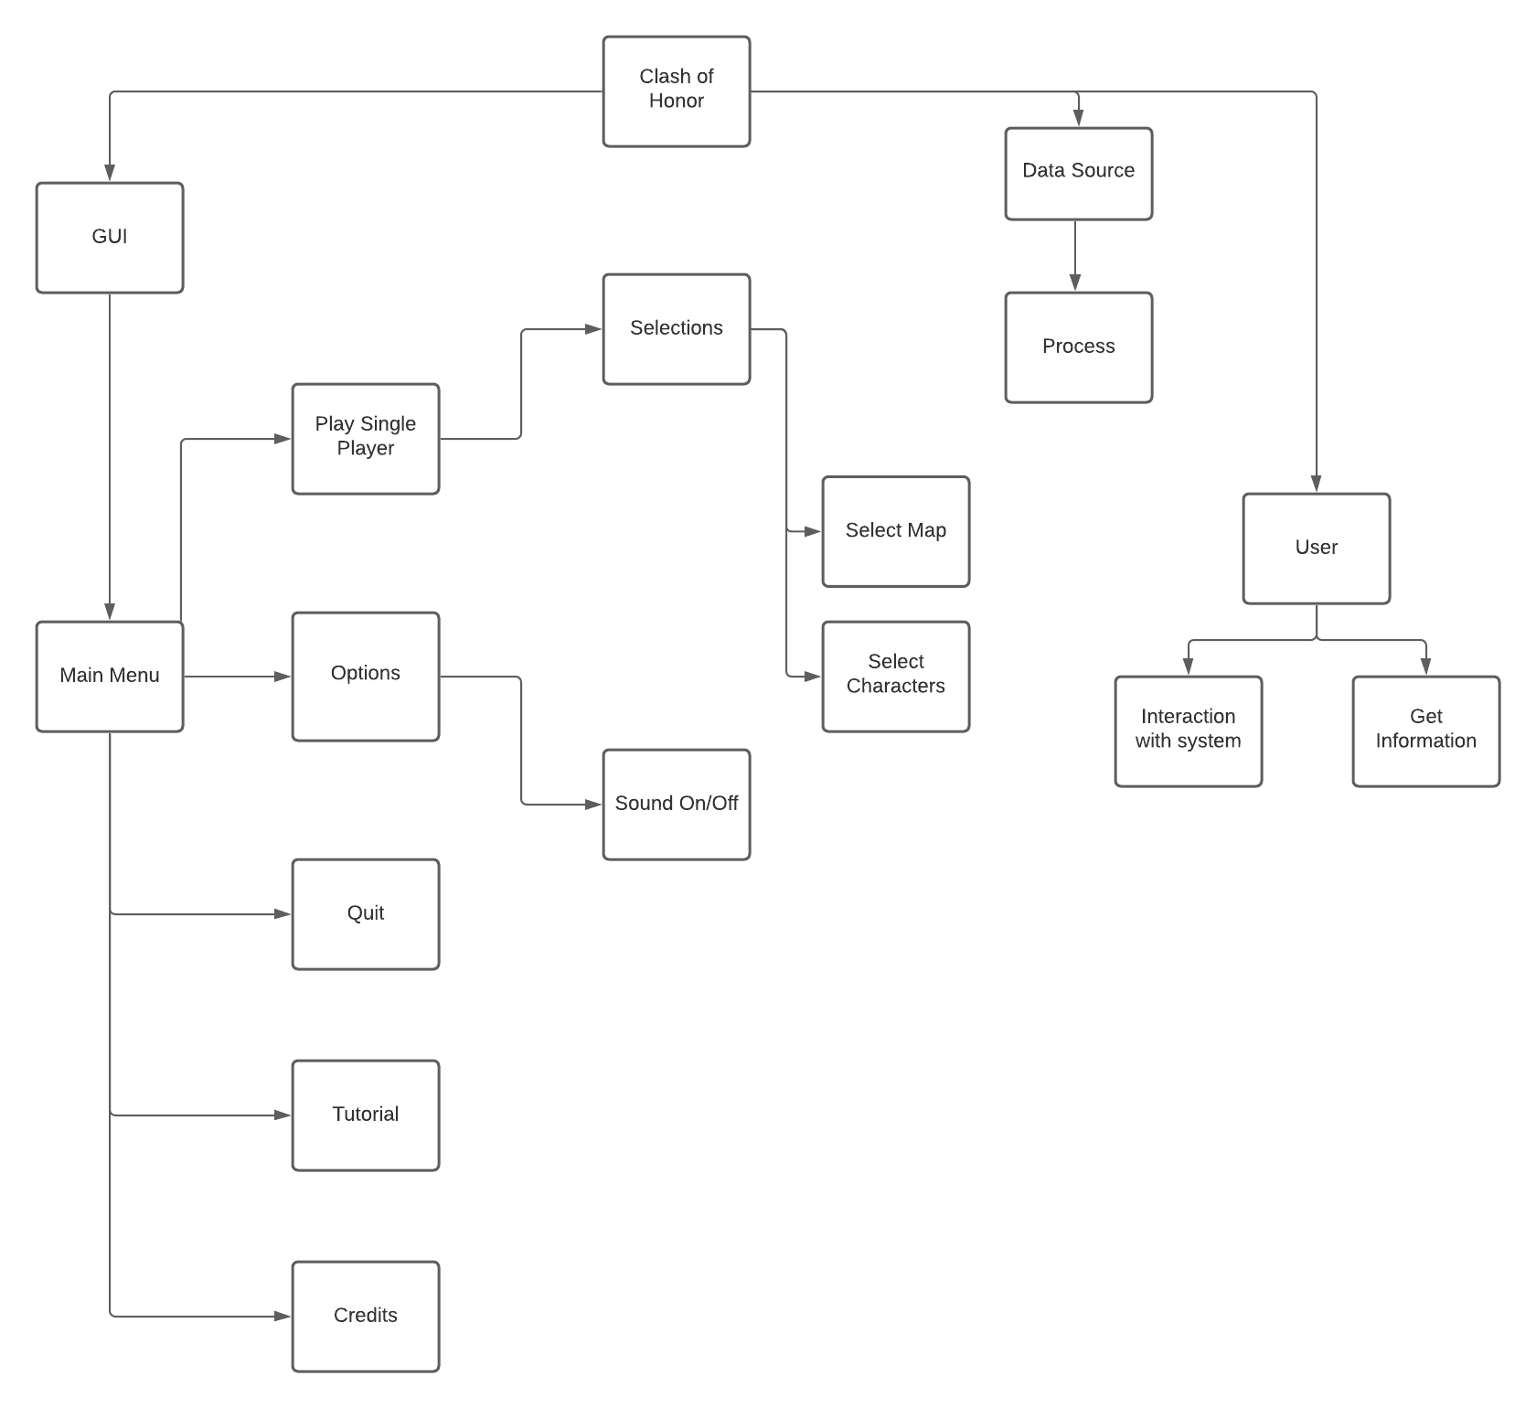
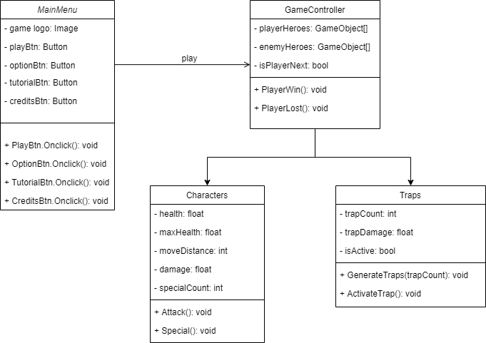




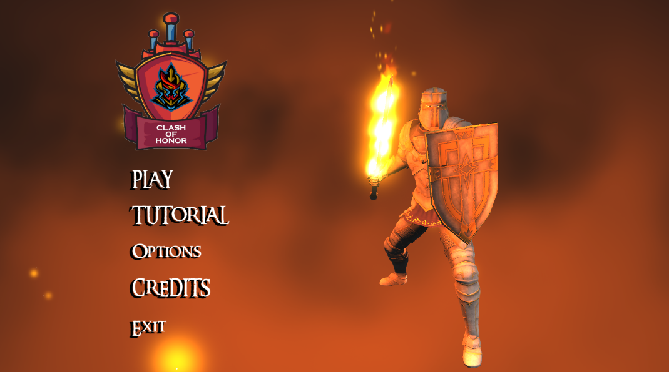
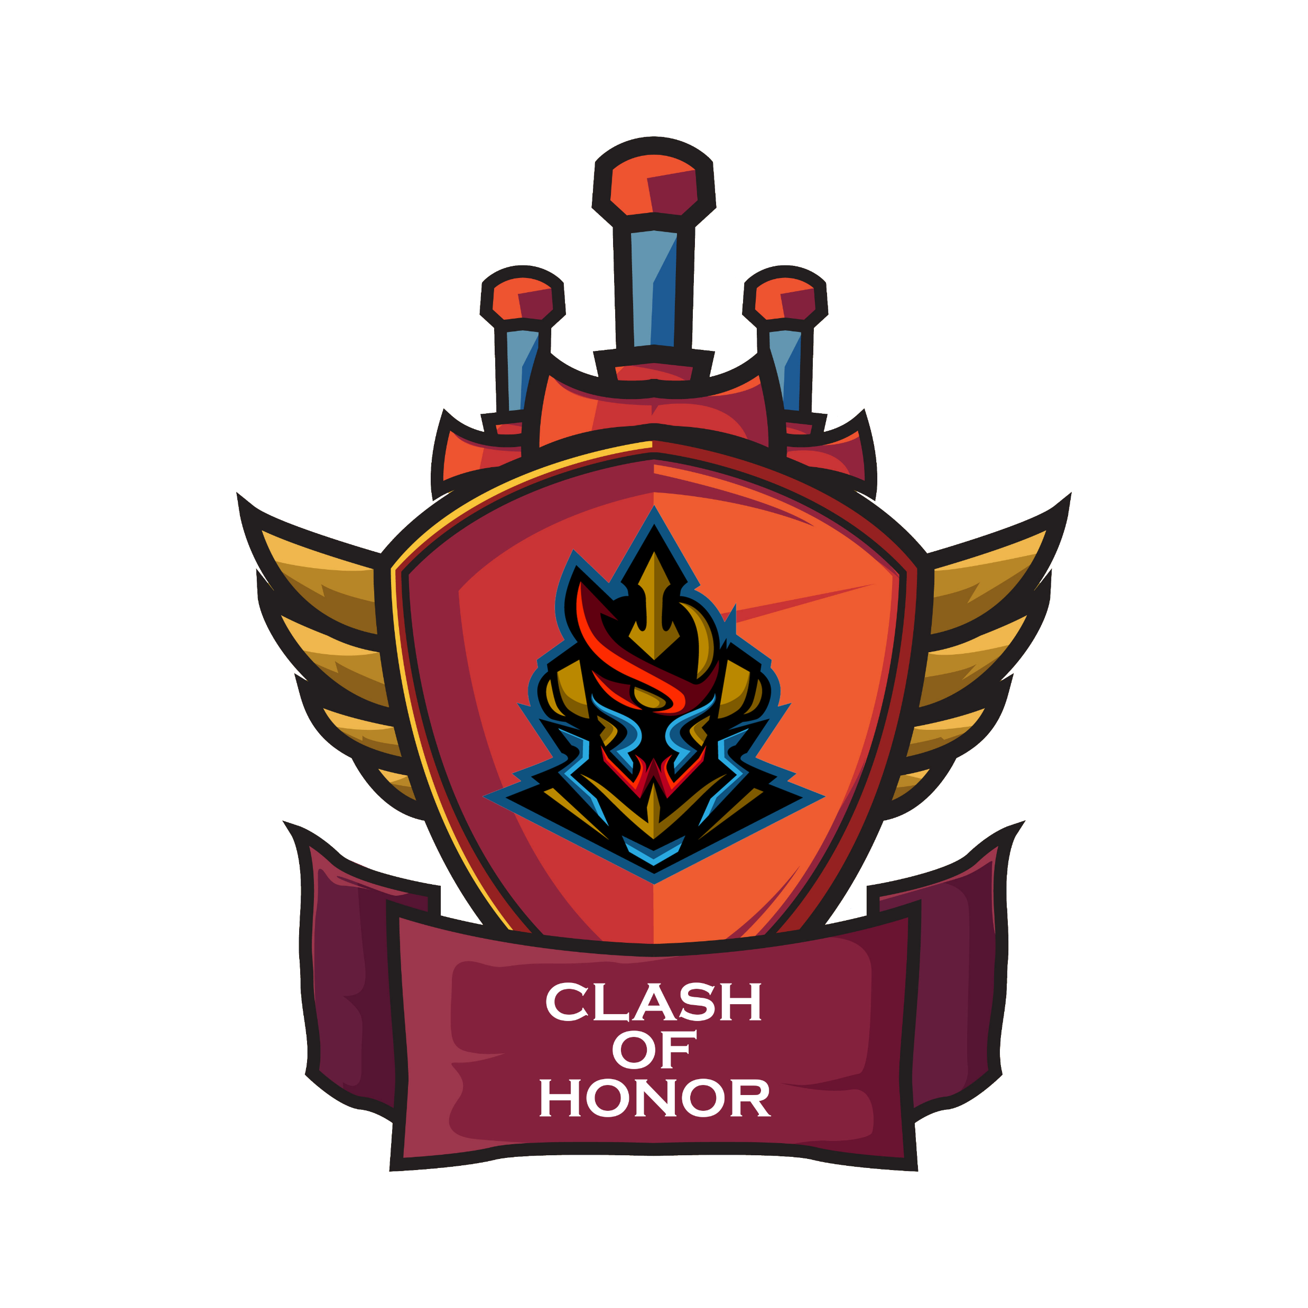



CLASH OF HONOR
Turn-Based RPG Mobile Strategy Game
Işık ALTUNTAŞ – Bülent Yetkin TÜMEN
Oğuzhan KAYA – Tolga GENÇ
Advisors: Dr. Hüseyin TEMUÇİN – Dr. Roya CHOUPANI
Çankaya University, Department of Computer Engineering
Abstract
Nowadays, it is the truth that video games are the best of one beloved merriment industries in the world. Even though video games are frequently acted by the kids and youth, there are many other aged people who also play those games. Moreover, video games progressively becoming even as a part of our acculturate. Today’s kids and human beings are laying their time on technological devices by playing video games. This examination is planned as an entrance to present thought as regards turn-based RPG strategy style video games’ role. In this literature appearance, we study, wrangle, and write down concerning turn-based RPG strategy games, singleplayer gaming, computer networks, algorithms, data structures, etc. This literature has a look at also goals to inform you about computer games, game engines, turn-based RPG strategy games.
Key Words: Video Games, RPG, Strategy, Mobile and PC Games, Game Engines, Unity, Singleplayer Gaming, Game Server, Effects, Animations, UI/UX, Sounds FXs, Controllers, Assets, C# Language, etc.
Figure 5 – Finished Product
Figure 1 – Activity Diagram
Figure 6 – Finished Product
Results & Conclusion
We progressed in our project by sharing the necessary sections and progressing systematically, we continued working to meet the requirements of the game and the project, we understood the importance of group work. Finally, we prepared the general tests and results of the project on paper.
The game engines contain the necessary materials for game developers. Game engines are the skeleton of the game. The software you need is supported by game engines. This software connects to scenes, color, sound, physics, and animation. Today's modern game engines provide realistic graphics. Game engine selection can push the quality of the game forward or backward in any aspect. All known game engines have their own methods and features. We designed and developed our game via Unity.
Introduction
The turn-based strategy game is a strategy game that players play in turn (usually a sort of war game, especially a strategic-level war game). Before computer games came out, people were able to play turn-based games such as chess and checkers on board. This trend continued with games such as Battleship and Monopoly after computer games came out, and these games are now being played on computers. This is different from real-time strategy in which all players play at the same time, just like chess, players can think for a certain amount of time before making their moves. While turn-based games prefer more strategic and transparent play, it can be a bit boring for players who are used to action-oriented games. The moves made in turn-based games can cause trade-offs and thus the game can go to different stages.
Figure 2 – Use Case Realizations
Acknowledgement
We would like to thank our advisors,
Dr. Hüseyin TEMUÇİN, and Dr. Roya CHOUPANI for guiding and supporting us during our senior project. They are example of excellence as researcher, instructor, and mentor.
Solution
The game framework comprises of one primary part and this segment has its own subsystem. The GUI configuration empowers collaboration between the player and the system. We aimed to establish a strategy outside of the standard chess rules. In addition, the user can turn on/off the volume at the required properties. The game contains two different maps. The maps contain nonplayable characters and objects. Our background music takes the player to the medieval atmosphere.
Figure 3 – Class Diagram
Dr. Hüseyin TEMUÇİN
Dr. Roya CHOUPANI
Işık ALTUNTAŞ
Bülent Yetkin TÜMEN
Oğuzhan KAYA
Tolga GENÇ
Figure 4 – Finished Product
Figure 8 – Project Members

